Slide 1
Software Engineering Unit-II
Prepared by: Neha Tripathi

Slide 2
Software Requirement Specification

Slide 3
Requirement Engineering Process
- Requirement Elicitation and Analysis
- Software Requirement Specification
- Software Requirement Validation
- Software Requirement Management

Slide 4
SOFTWARE REQUIREMENTS SPECIFICATION (SRS)
After the analyst has gathered all the required information regarding the software to be developed, and has removed all incompleteness, inconsistencies, and anomalies from the specification, he starts to systematically organize the requirements in the form of an SRS document.
The SRS is the official statement of what is required of the system developers.
It include definition of user requirements and a specification of the system requirements.
SRS should set of WHAT the system should do rather than HOW it should do it.
Among all the documents produced during a software development life cycle, SRS document is probably the most important document and is the toughest to write. One reason for this difficulty is that the SRS document is expected to cater to the needs of a wide variety of audience.
Users of SRS Document- Users, customers, and marketing personnel, Software developers, Test engineers, User documentation writers, Project managers, Maintenance engineers etc.

Slide 5
SRS
SRS document is considered to be a basic reference document.
SRS document serves as the documentation of a contract between the development team and the customer.
SRS serves as an agreement as it is signed by Customer and developers both .
The SRS document can be used to resolve any disagreements between the developers and the customers that may arise in the future.
The SRS document can even be used as a legal document to settle disputes between the customers and the developers in a court of law.
Once the customer agrees to the SRS document, the development team proceeds to develop the software and ensure that it conforms to all the requirements mentioned in the SRS document.
The SRS document should describe the system to be developed as a black box, and should specify only the externally visible behavior of the system. For this reason, the SRS document is also called the black-box specification of the software being developed.

Slide 6
Parts of a SRS document
The important parts of SRS document are:
Functional requirements of the system-functional system requirements describe the system functions, its inputs and outputs, exceptions, etc., in detail.
Non-functional requirements of the system -Nonfunctional requirements deal with the characteristics of the system which can not be expressed as functions - such as the maintainability of the system, portability of the system, usability of the system, etc.
Goals of implementation-The goals of implementation part documents some general suggestions regarding development. These suggestions guide trade-off among design goals. The goals of implementation section might document issues such as revisions to the system functionalities that may be required in the future, new devices to be supported in the future, reusability issues, etc.

Slide 7
Characteristics of a Good SRS Document
Concise
Structured
Black-box view
Conceptual integrity
Response to undesired events
Verifiable
Modifiable/Maintainable
Traceable
Scalable
Testable

Slide 8
Attributes of Bad SRS Documents
Over-specification
Forward references
Wishful thinking
Noise

Slide 9
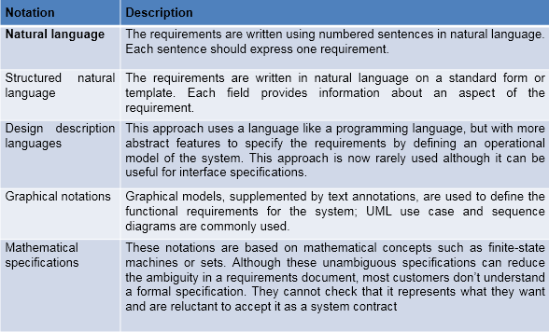
Ways of writing a system requirements specification

Slide 10
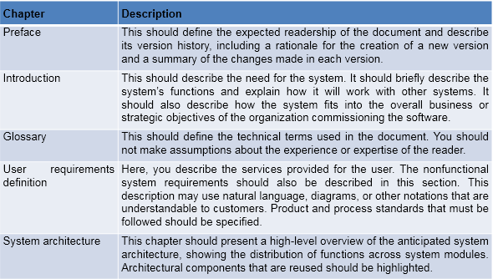
The structure of a requirements document

Slide 11
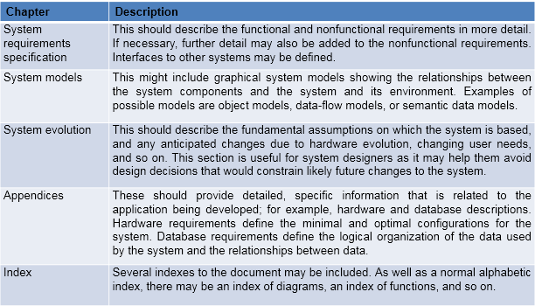

Slide 12
Problems without a SRS document
Without developing the SRS document, the system would not be implemented according to customer needs.
Software developers would not know whether what they are developing is what exactly required by the customer.
Without SRS document, it will be very much difficult for the maintenance engineers to understand the functionality of the system.
It will be very much difficult for user document writers to write the users’ manuals properly without understanding the SRS document.

Slide 13
Thank You!

